Slide 1
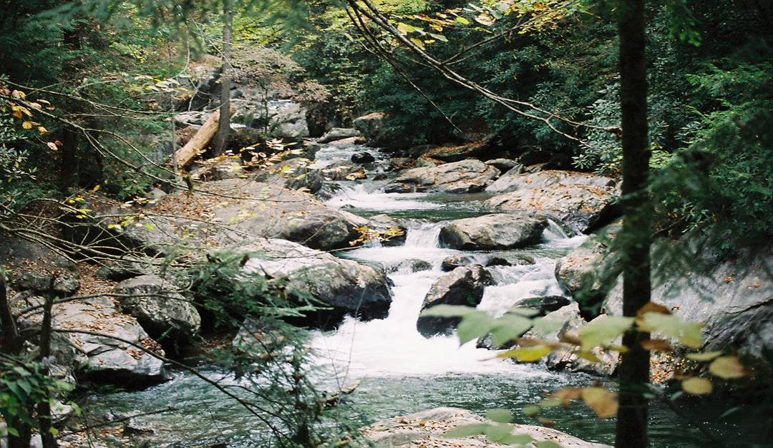
KENTUCKY WATERSHED WATCH
PROGRAM LOGISTICS
Effective Date: 04/01/2013

Slide 2
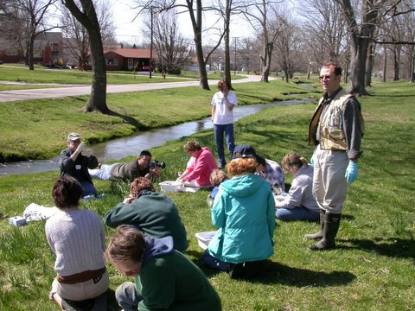
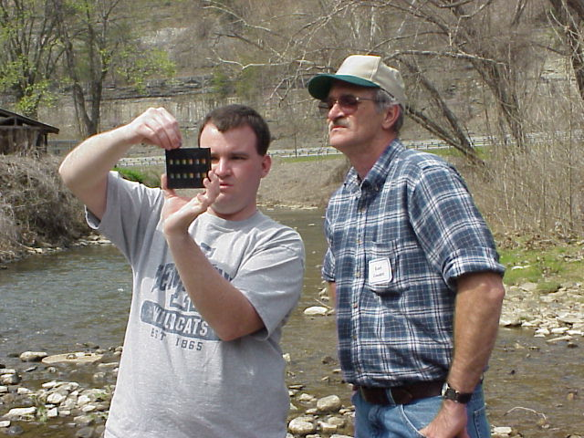

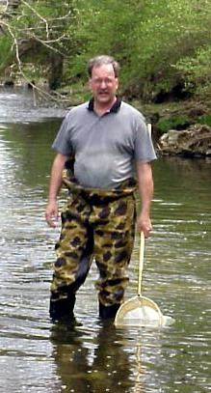
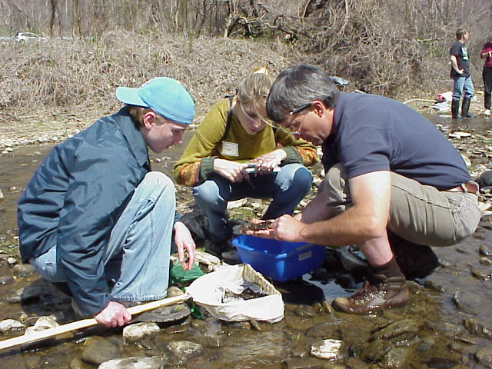
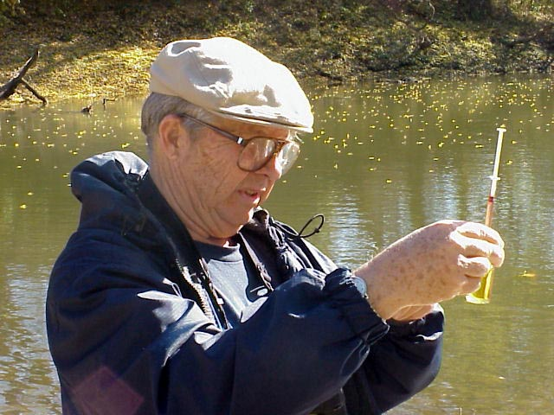
Notes:
We would like to tell you about the Watershed Watch Program and how we operate.
The Watershed Watch groups in Kentucky are all nonprofit organizations
The goal of Watershed Watch is to provide volunteers with the training and equipment necessary to determine the status of streams in their communities, so they can take action locally to protect or restore them
Why should this be important to us? We all use our streams or groundwater as a clean source of drinking water. The dirtier that water is, the more of our tax dollars must be spent on cleaning it for our use. In addition, many of us rely on our streams for recreation, food production (irrigation for plants and drinking water for livestock), and industry. Streams also provide support for wildlife and are a vital part of a healthy environment.
Watershed Watch data are also used by local watershed planning groups, to provide information (when available) to citizens when there are complaints to the Division of Water regarding a specific stream, for DOW TMDL studies (when collected in coordination with DOW and using an approved quality assurance plan), and for assisting with targeting DOW professional monitoring activities
The continued and expanded use of Watershed Watch data depends upon the training of volunteers in approved sampling procedures and the conscientious use of those procedures by each volunteer to ensure consistent, high quality sampling results across the state

Slide 3
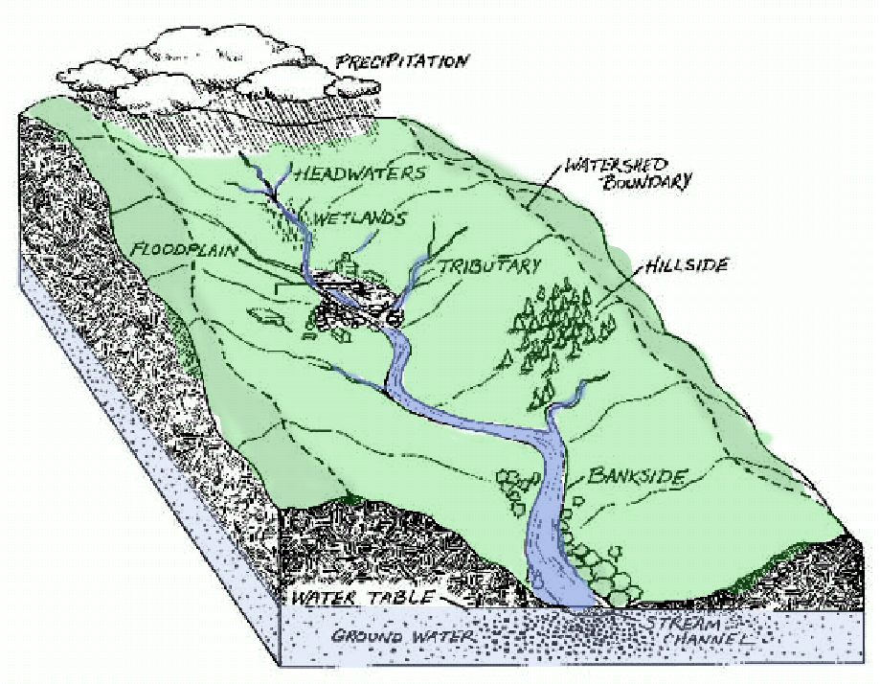
What is a
Watershed?
Notes:
Explain to everyone that a watershed is the land area that drains to a common point
Mention that this includes groundwater moving under the surface as well as surface water moving above surface
Take time to discuss how/why we use a watershed as the basis for our organizational structure
Talk about how the hydrologic units work for watershed management
The work we do is based on studying our watersheds and acting on the data we collect

Slide 4
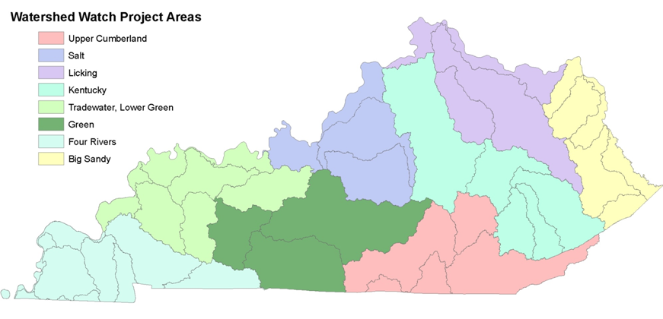
Watershed Watch Is Statewide
Notes:
We want people to know that this is a statewide organization
There are 8 Watershed Watch groups that all operate similarly to the basin in which you are located
Be sure you point out the basin sponsoring the workshop and identify its area and explain its general hydrology.
If applicable, may want to explain that there are some tributaries that drain directly into the Ohio River (not to the main river in the basin), but are associated with the basin for management purposes

Slide 5
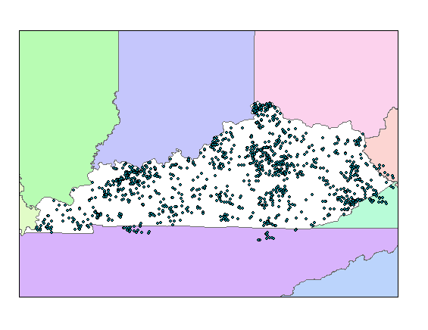
Active Watershed Watch Sampling Sites
Notes:
As of 2012, Watershed Watch has over 1100 active monitoring stations across the state visited by over 900 Watershed Watch volunteers. Active stations are visited up to four times a year by our supervising samplers.
By the end of this workshop, we hope you will be willing to take one of these stations, or add a new station that interests you
If applicable, may note that watersheds do not follow state or county boundaries (explains sites outside of state)

Slide 6
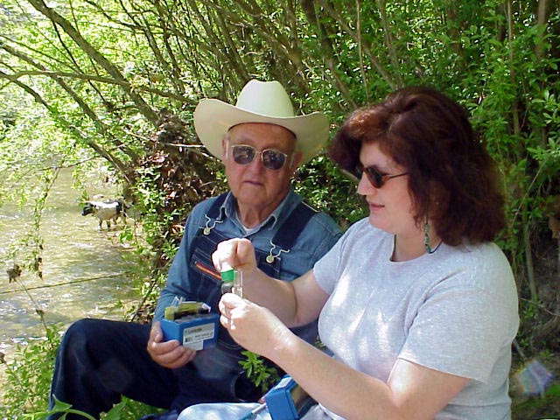
Watershed Watch
Program Overview and Logistics
Goals for this module
Discuss the goals and objectives of this program
Learn who we are and how we are organized
Learn about our basic activities
Determine the streams and sites you want to work on
Complete essential registration paperwork
Check out the equipment you need
Notes:
This slide explains how this workshop (the introduction to the Watershed Watch program) is organized
Optional: Ask volunteers about their interest/motivation for joining Watershed Watch

Slide 7
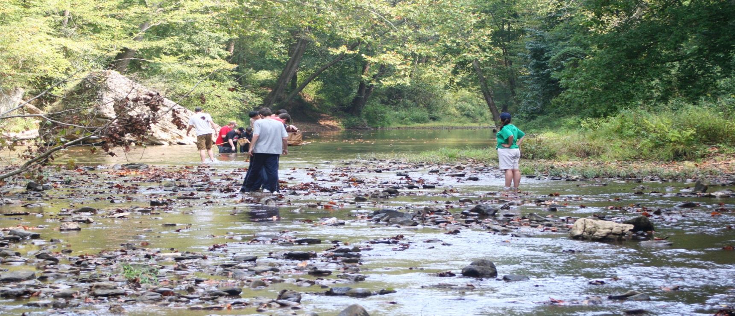
Mission Statement
Watershed Watch in Kentucky is a statewide citizens monitoring effort to improve and protect water quality by raising community awareness, and supporting implementation of the
goals of the Clean Water Act.
Notes:
This is the WWKY mission statement (if your basin statement differs, modify this slide).
Note the reference that it is a citizen and community effort, that our mission is monitoring to raise awareness and that we support the goals of the clean water act of protecting our streams for fishing, swimming, drinking water supply and aquatic life uses

Slide 8
Goal: Get people into the real world to see first
hand the condition of their streams.
Notes:
Our main goal is to get people to the water’s edge with the tools of science, so that they can learn about streams that are of concern to them

Slide 9
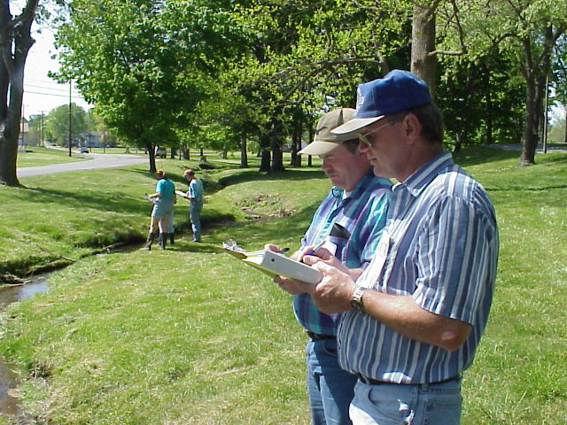
You are the real purpose of this program
Notes:
The stream data we generate is important, but the real value of our work is you
As an individual armed with knowledge and current information, your presence in a watershed will help raise awareness of the issues, be a deterrent to would be polluters, and help focus resource management efforts on the issues you identify
We strongly encourage you to use your knowledge locally to make a difference and help improve or protect your local streams and watersheds

Slide 10
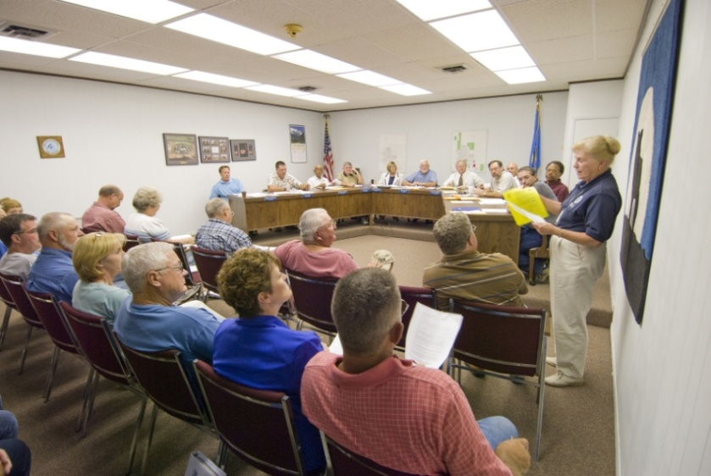
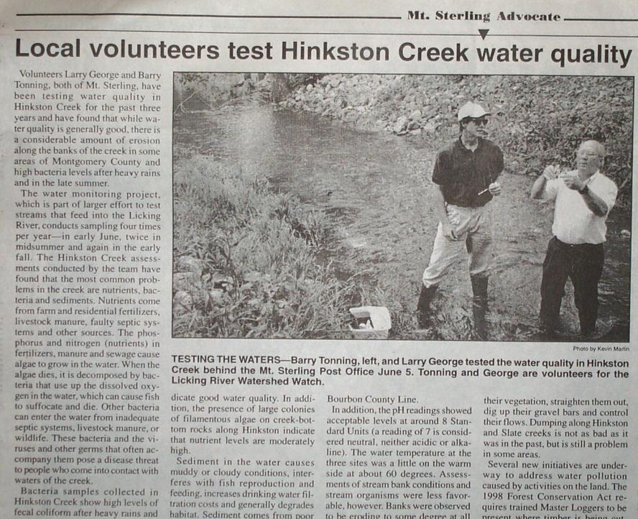
Watershed Watch provides you the tools and information you need to
educate and inform
You
Family
Friends
Neighbors
Community
Local Leaders
Resource Management Agencies
Notes:
Watershed Watch empowers you to become an educator and take action about your stream and watershed
This can be anything from informing yourself and your family about the safety of your favorite stream to working with local officials and resource management agencies on projects to help improve and protect your watershed

Slide 11
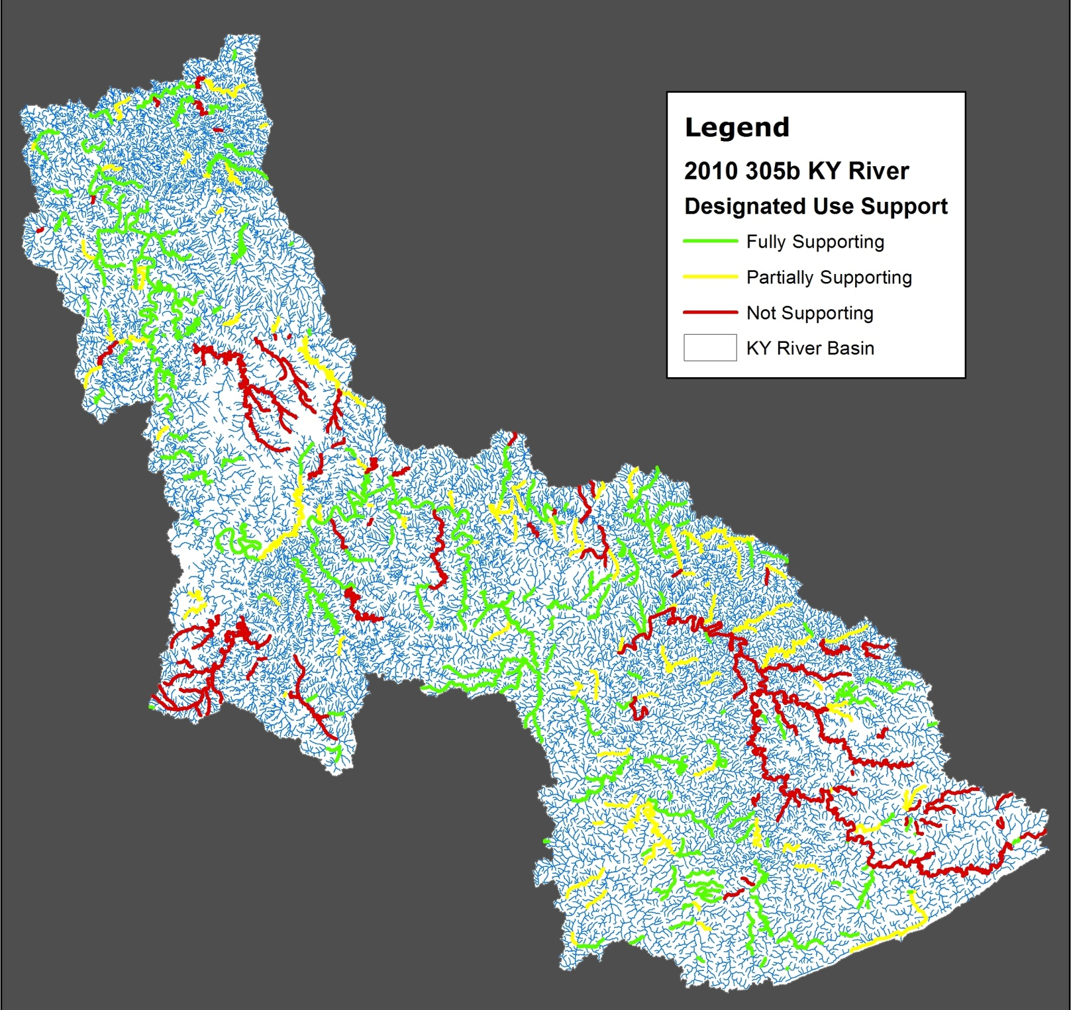
Why will our work make a difference?
…because there is not enough good information on the state of our water!
Notes:
Basin-specific slide – presenters please edit as necessary.
Green, yellow, and red streams have been assessed for swimming use. Explain these use support categories:
Green = full support
Yellow = partial support
Red = nonsupport
Streams that appear blue on map have not been assessed by KDOW. Also, stress that the streams on this map are the very large streams in the basin, and that for smaller streams (that don’t appear on the map) we do not have information.
Watershed Watch is extremely important to fill the gaps in our information and knowledge about the streams resource management agencies are unable to assess
NOTE: Map can be obtained from the KDOW website at:
http://water.ky.gov/waterquality/Pages/IntegratedReport.aspx
Use maps from Volume I of the Integrated Report - Appendix B

Slide 12
How we’re set up:
Watershed Watch In Kentucky
Board of Directors
Basin Steering Committee or Board of Directors
Sampling Event Coordinator
Lab Manager
Science Advisor(s)
Area
coordinator
Area
coordinator
Area
coordinator
Watershed Watch Trained Sampler
Watershed Watch Trained Sampler
Watershed Watch Trained Sampler
Watershed Watch Trained Sampler
Notes:
Here is our basic organizational structure. (You may want to identify who these people are in your basin)
The most important people on this chart are the “Watershed Watch Trained Samplers”. You will be one of these folks after this workshop. They perform the data collection and sampling effort on the ground.
Area coordinators (usually at the county level) help be sure new volunteers are trained, that sampling events run smoothly and that you have the equipment, materials and information you need to do your work
Lab managers Sampling Event Coordinators plan the details of our unified sampling events
The steering committee has a group of science advisors who help us with being sure our data collection efforts are scientifically valid and useful. They also assist with interpreting the data once we get it.
Each basin has a volunteer steering committee/board that is responsible for organizing the basin for the year, conducting these training workshops, planning the data collection efforts and holding the annual conferences
We have a statewide Watershed Watch In Kentucky organization composed of representatives from each of our 8 basins. They develop new initiatives, solve problems and help raise funds for the program.

Slide 13
What we do:
1. Train and certify volunteers
2. Conduct field assessments
3. Collect samples for lab analysis
4. Discuss and interpret results
5. Achieve citizen action
Notes:
Here is an overview of our basic activities (Don’t launch into detail here, more will come later!)
Stress that the WE is the collective we, including volunteers (especially in context of #3)

Slide 14
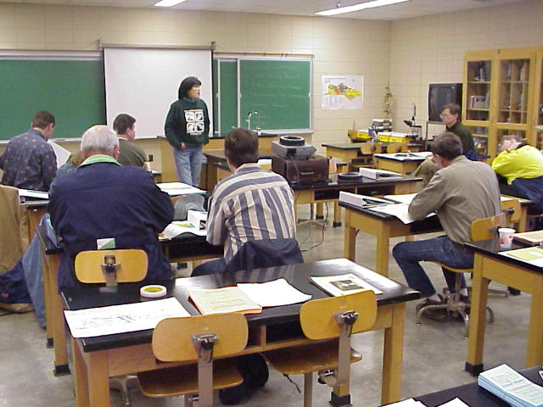
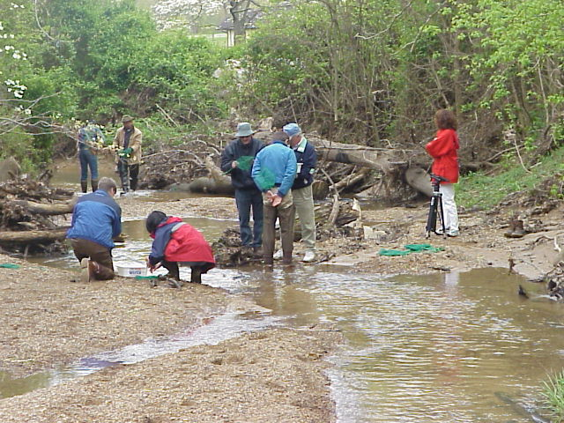
Training and Certification Workshops
Phase 1
Field Chemistry Assessment
Grab Sample Collection
Phase 2
Biological Assessment
Habitat Assessment
Notes:
We have four types of assessment, taught in two phases for our training workshops. These four assessments, when combined, provide the best overall picture of stream health. We strongly encourage you to become trained in all of them.
Today’s workshop will focus on Field Chemistry Assessment and Grab Sample Collection.
If you have not already done so, please register for a biological and habitat assessment workshop that complements today’s workshop (more later).

Slide 15

When in Rome…
Common Measurements
Common Language
with resource management agencies
Notes:
Our sampling is done using standard professional measurements so that you can communicate with resource management agencies on their level (and on equal footing)
So, please have patience with the new terminology involved!

Slide 16
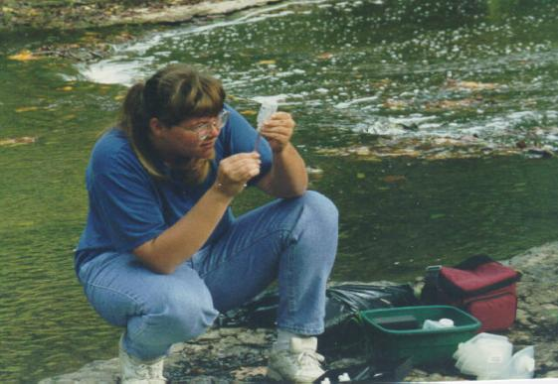
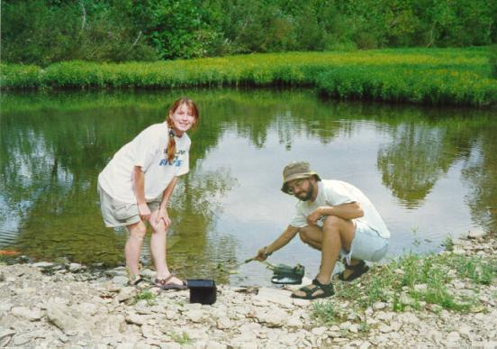
Phase 1-Field Chemistry Measurements
Analysis that can
only be done at
the creek
pH
Dissolved Oxygen
Conductivity
Temperature
Notes:
One of the important activities we ask you to do is conduct field chemistry measurements
Field chemistry tests will be covered in today’s workshop
These measurements can only be done on the stream, (you can’t take these samples back to the lab)
We will issue you the equipment to do this and show you how to use the gear

Slide 17
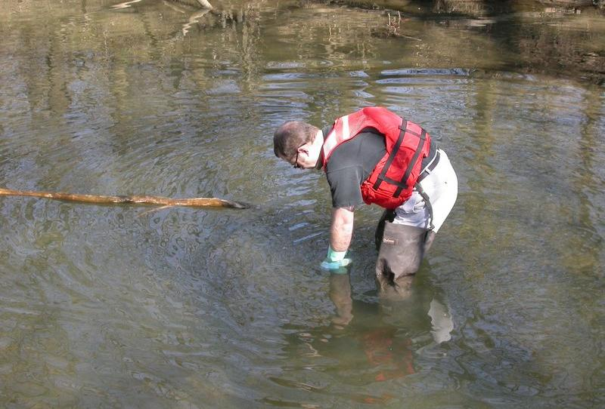
Phase 1 - Grab Sample Collection
for Laboratory Analysis
Pesticides or other parameters, Spring
Pathogens, Summer
E. coli or Metals & Nutrients, Fall
Notes:
Basin-specific slide – presenters please edit as necessary
Grab sample collection will be covered in today’s workshop
We do these in the spring, summer and fall

Slide 18
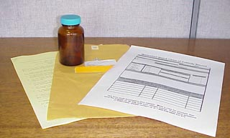
Volunteers receive materials by mail
or from their area coordinator,
instructions are included
(Critical info on sample times and delivery included)
Notes:
Prior to each sampling event, your watershed sampling event coordinator or lab manager will ship you sample containers, essential paperwork and instructions.
Don’t go into detail here – specifics on materials are covered in Grab Sample module

Slide 19
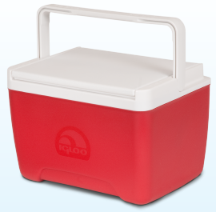
Sampling Event Logistics
Sample
Sample
Sample
Sample
Runner
Drop
LAB
Off
Sample
Notes:
On a designated day, everyone goes out and collects these samples
You then have to connect with a runner or drop off center to get your samples to the lab
Some of these events run under a tight clock since samples have to be delivered to a lab under certain conditions and in a specific time frame
Don’t go into detail here – specifics on sample event delivery/logistics are covered in Grab Sample module

Slide 20
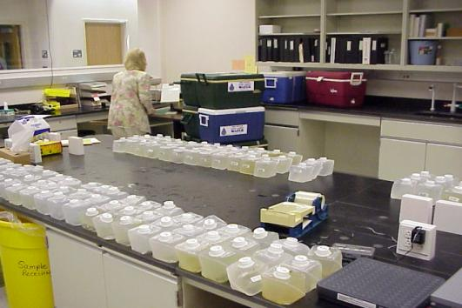
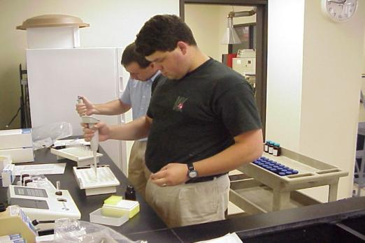
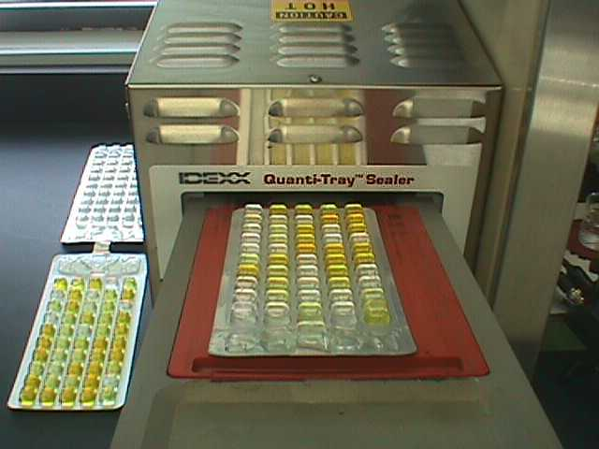
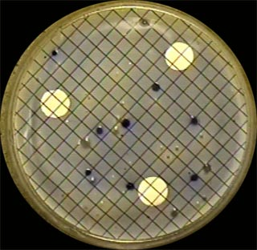
Professional labs analyze samples
Notes:
The samples are taken to professional laboratories for analysis
We use labs that are on the State’s certified lab list, or that the resource management agencies use for their own analysis. This is expensive, but are required to meet our program’s high standards for data quality.
Do not go into detail here – Grab Sample module explains sample analysis

Slide 21

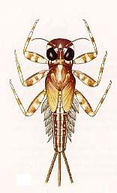
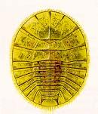
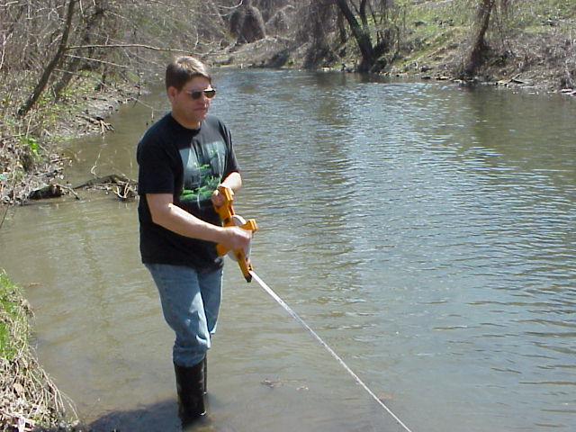
Phase 2 – Biological and Habitat Assessment
Biological Assessment
Benthic Macroinvertebrate Collection
and Identification Methods
Classroom and Streamside
Instruction
Habitat Assessment
Stream and Watershed Investigation
Methods
Classroom and Streamside Instruction
Notes:
Briefly describe the Biological and Habitat Assessment program (Phase 2)
Use this as an opportunity to invite volunteers to participate in this program and explain the value of pairing Phase 1 information with Phase 2 information to more fully describe/explain their stream site/watershed
Note that Phase 1 training is a prerequisite to Phase 2

Slide 22
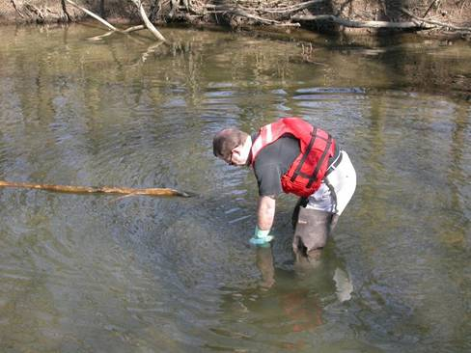
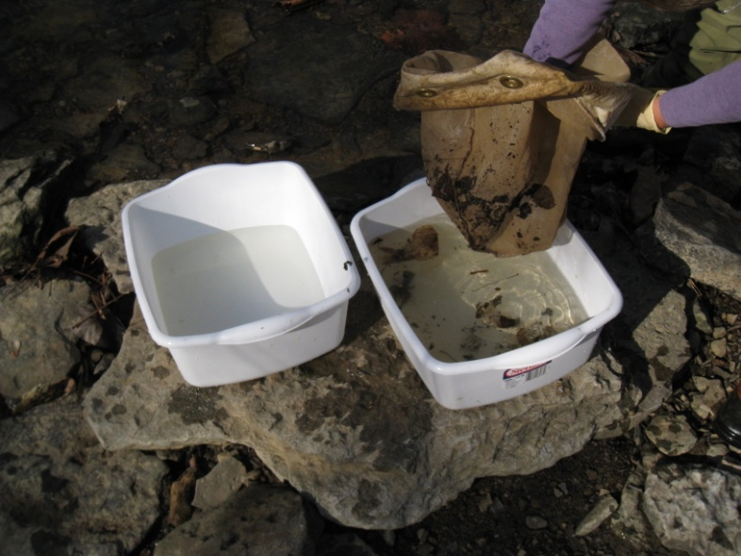
Streams are constantly changing
GRAB SAMPLE &
FIELD CHEMISTRY
Instantaneous water
quality
Quick process
Specific pollutant
analysis
BIOLOGICAL & HABITAT
ASSESSMENT
Water quality over
time
Takes more time
Collective pollution
indication
VS.
Notes:
Streams are the epitome of dynamic systems, as they are constantly changing
A grab sample and/or field chemistry assessment provide a relative view of the overall quality of a stream at any given moment. The section of stream that is polluted today may be flushed clean next week. A sample collected a week after a spill, for example, may not indicate that the pollution had occurred. A sample taken while pollution is occurring could determine any specific pollutants.
The effects of pollution, however, may be dramatic, and are reflected in changes in the variety and abundance of macroinvertebrate populations and/or changing habitat conditions. Biological/habitat assessments provide a relative view of the overall quality over time in the stream. It would not tell you what type of pollution had occurred, but is a collective indicator of pollution.
Stress the value of pairing grab sample/field chemistry with the biological/habitat assessments

Slide 23
How are the data managed?
Lab sends results to “basin data manager” and KY Water Watch office
Data manager reviews for accuracy
“Draft” report circulated for review and corrections
Revised report sent to KY Water Watch Office and to Kentucky Geological Survey (KGS)
Data entered into KGS database and mapped – http://kgs.uky.edu/kgsmap/krww/viewer.asp
Reports released at year-end conference
Data archived in electronic format and in a “hard copy” at the KY Water Watch Office
Notes:
Explain the process of data flow after sample is dropped off at laboratory for analysis

Slide 24
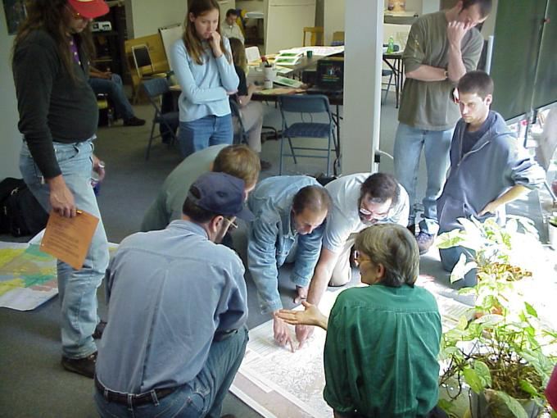
Develop and Implement Citizen Action
How You Can Follow Up in Your Watershed:
  Develop a plan of action based on your findings
  Conduct more detailed sampling (Focus Study)
  Inform local officials and/or community
  Form a watershed group
Notes:
The first step of citizen action was you becoming involved as a volunteer for Watershed Watch. An important next step in this program is using the information you have collected to take action in your watershed.
If your monitoring indicates a potential problem, then you can ask the Basin Steering Committee/Board and its science advisors for help. They will work with you to follow up in your watershed.
These are just a few of the many types of action you can take in your watershed:
Develop a plan of action based on your findings – you determine the extent and complexity of this plan, based on your perceived needs in the watershed, and it can be completed with or without the assistance of your board/steering committee; or write a “Citizen Action Plan” (CAP) – the CAP formalizes specific steps that you and others can take to address your concerns about the watershed
Conduct more detailed sampling (Focus Study) – take samples on a more frequent basis in additional locations in your watershed. If you are interested, talk with your Basin Steering Committee/Board.
Inform local officials and/or community – this can range from talking with your neighbors to writing a newspaper article to presenting your information at a city council/fiscal court meeting
Form a watershed group – sometimes working with people that share your concerns can improve your effectiveness
Keep in mind that most problems in your watershed have developed over long periods of time, and fixing them may also take a long time
You are welcome to attend or join the steering committee/board meetings at any time!

Slide 25
How you can use your information
Personal decision making
Local action
Grant applications
Watershed planning
Assessment screening
Enforcement efforts
Scientific research
Data usage depends on the quality control applied…
Notes:
Describe how volunteers can/should use their information
This ranges from “personal decision making” at the top of the list – to assessment, enforcement, and research purposes as you move down the list
Explain that as you move through this list from top to bottom, the level of standards that are maintained (quality control) in the sample methods and analysis

Slide 26
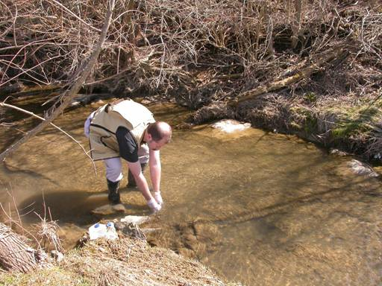
Standard Operating
Procedures (SOP)
For good Quality Assurance of results, we require:
Training workshops for certification
Standard methods of collection
Standard methods of analysis
Full chain of custody and/or forms
Careful recordkeeping!
Notes:
We have documented the procedures we use across the state for sample collection in the “Standard Operating Procedures” or SOP
You will be given a copy of this document on CD
Use your flip cards as reminders at the stream!
These procedures are the same for everyone across the state, which assures good quality data and allows equal comparison across the state. Emphasize that the reason they are called Standard Operating Procedures is because everyone uses the same procedures.
Please review these documents sometime before you take your first grab sample, and anytime that you have a question about our program/procedures

Slide 27
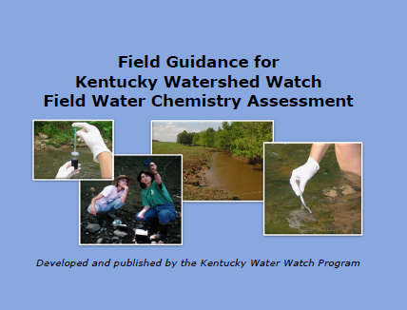
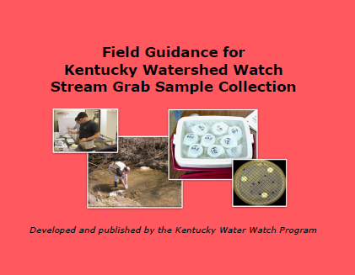
Standard Operating Procedures (SOP)
To ensure standard methods of collection, always use
flip cards
when sampling:
Notes:
Always use your flip cards as reminders at the stream!

Slide 28
Phase 1 (Program Logistics, Field Chemistry
and Grab Sample) Training:
Your sampling and field testing skills are considered
current for three years after completing
WWKY-approved training
Training updates must be completed at least every
three years
In addition, chemicals must be replaced every three
years for your field test results to be accurate. These
chemicals should be replaced at your training update.
Recertification
Notes:
The updates and certification for grab samples help us as an organization stay current with the latest protocols and sampling techniques
Regular (3-year) updates are only necessary for grab sampling

Slide 29
Phase 2 (Biological and Habitat Assessment)
Training:
Your sampling and assessment skills are considered
current after completing WWKY-approved training
You will be notified that training updates are required
if modifications are made to WWKY methods
Recertification
Notes:
The updates and certification for grab samples help us as an organization stay current with the latest protocols and sampling techniques
At this point, updates are only necessary for grab sampling

Slide 30
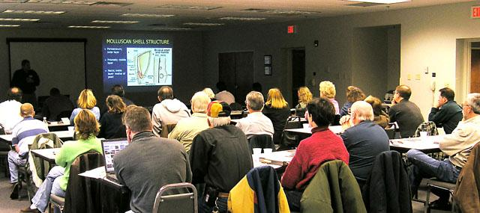
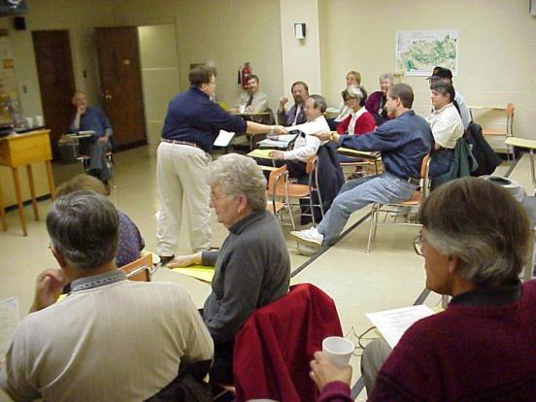
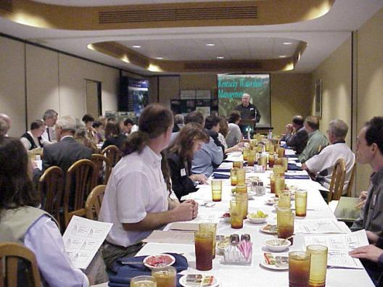
Annual Conferences
1. Discuss findings
2. Network with fellow
volunteers and
agency
representatives
Notes:
Our monitoring data is important, but interpreting the data can be a challenge
That is why our annual conferences are such an important part of this program. At our annual conferences, we gather to discuss our findings and sort out what it means, and what we can do about it. We hope you can make plans to attend this event. (You may want to announce date and time for this conference if known)
Our conferences are also important networking opportunities for your watershed protection efforts. It is helpful to know who is doing what in the basin, and to get to know them (and them to know you)
People that miss these conferences miss a lot of what this program has to offer

Slide 31
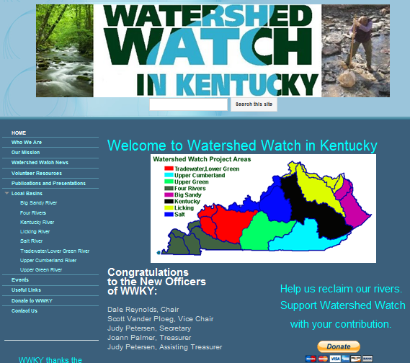
How do I find out more
about my basin?
Go to your basin’s
Watershed Watch
Webpage through the
“Quick Links” at:
http://www.wwky.org
Notes:
For questions about your local basin’s organization and activities, link to your basin webpage through the KDOW Watershed Watch webpage
Many basins produce reports that compile all of the annual data, and can be found for specific basins at the appropriate “Quick Link” at:
http://www.wwky.org

Slide 32
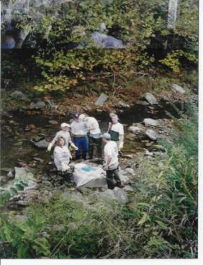
Selecting your stream site
General Selection Criteria:
Identify a site that interests you
Select sites that are accessible and shallow
enough to wade in, but deep enough to
submerge and fill a variety of sample container
sizes
Notes:
In addition to your contact information we will be asking you to designate the sites you want to collect grab samples
In a few minutes, we will take a break and work with you more closely to help you choose a site that interests you and is meaningful to the program
As a volunteer, you get to pick a stream site that you would like to know more about. Here are a few criteria on selecting your site(s). We want you to take one or two sites. We would not recommend taking more than two until you are comfortable with the activity and you know you can cover them.
Additional considerations for site selection:
· Proximity to existing Watershed Watch sites
· Safe access to the site using public rights of way and/or the permission of the property owner
· Physical safety in accessing the stream via the streambank
· Wadeability of the stream (Note that if volunteer would like to participate in biological/habitat assessments, a 200m
reach containing the sampling location is required)
· Representativeness of the stream reach (channel morphology and riffles)
· Reach mixing (sites near major tributaries or point sources should be avoided to minimize
backwater effects or poorly mixed flows)
· Consider the proximity to major man-made disturbances like bridges, dams, or roads
Under normal climate/weather conditions, stream maintains adequate flow of water through sampling season
· Be aware of potential health risks in the stream, e.g., proximity to a treatment plant or “straight pipes”

Slide 33
Site Information
1. Stream name (use map if needed)
2. Description
  Correct!
  50 meters upstream of Hwy 1533 bridge
  100 m Due South of Knott Central High school
3. Latitude and Longitude
  GPS (decimal degrees – 5 decimal places)
  OR Digital map (KGS Watershed Watch website –
  http://kgs.uky.edu/kgsmap/krww/viewer.asp
  or Google Earth)
  Submit information to Water Watch office
  Email: OllieTheOtter@ky.gov Phone:1-800-928-0045
Notes:
It is critical we get clear and precise location information. Ideally, at this workshop we could determine the latitude and longitude for your site in decimal degrees! But at a minimum, we need a good written description that describes where you are sampling close enough that someone with a topographical map or county road map could find it should be recorded on your Participant Agreement.
For example, everyone in your town may know where Suggins Grocery used to be before it burned down, but anyone unfamiliar with your location that wants to use your data may not!
If you don’t know the specific sites you want to sample while at the workshop, that’s OK, but please do so as soon as possible after the workshop. You can use the KGS Watershed Watch website or a GPS unit at your sample site to determine the latitude and longitude in decimal degrees. Please report this information in an email or phone call to the Water Watch office.

Slide 34
Be Safe!
•During high flow, sampling should be postponed until baseline conditions exist – do not sample in any unsafe conditions
•Waders and specialized wading boots can be utilized
•Use extreme caution when wading in streams above the knee
•Samplers should exhibit caution in and around streams to reduce the threat of a falling injury
•Secure permission from landowner
•Be aware of increased risk for frostbite or hypothermia in cold temperatures
•Do not stick hands or feet under large objects. Exercise caution when handling aquatic life. Some organisms pinch, bite, etc.
All water bodies have the potential to be contaminated
Notify others of your whereabouts and carry a cell phone
Use caution and be aware of your surroundings and location
Notes:
Read through each bullet while emphasizing each volunteer’s personal responsibility for their safety and health.
Also explain that Watershed Watch expects each volunteer to put their personal safety above all else when participating in WW activities.

Slide 35
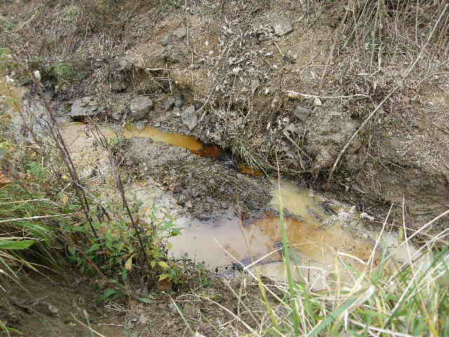
Environmental Safety
IMPORTANT: If you observe an outfall, pipe, or anything that might indicate illegal pollution of a waterway, contact Kentucky Division of Water to report complaints or concerns at 502-564-3410
during business hours.
For environmental emergencies such as spills of gas, oil or other substances, contact the Environmental Response Team at 502-564-2380 or 1-800-928-2380.
Notes:
The only time you should contact the Environmental Response Team is for an environmental EMERGENCY. This can be equated to the environmental version of “911”.

Slide 36
Questions?
If you have any questions after today’s workshop,
please contact your “Area Coordinator” or the
KY Water Watch Office at 1-800-928-0045
Notes:
NOTE: trainers should communicate to volunteers who the appropriate contact person is for their basin. Individual basins need to provide contact information for their new volunteers, should they have future questions about the program.
Remember, you are not alone. Your first point of contact is your area coordinator or basin leadership.
You can always reach someone (during normal business hours) to answer questions at the KY Water Watch Office

Slide 37
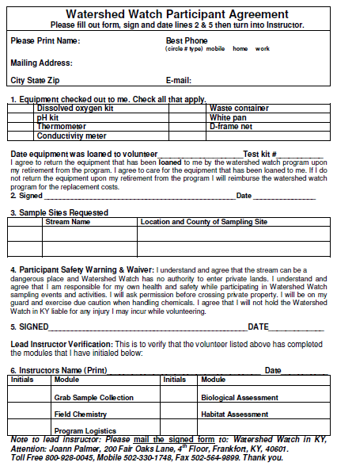
Participant
Agreement
Records:
Accurate contact
information
Equipment loaned
Site(s) selected
Training received
Notes:
Please pull out your “Participant Agreement Form”
This is a record that you have been trained as a certified water sampler. You will receive a copy of your agreement from the Water Watch office along with an Associate ID card.
This outlines the various activities we are asking you to participate in, identifies what locations you want to sample, lists any equipment we provide you with today, and includes a disclaimer/agreement.
By completing this form, we can be sure you get the materials and support you need to start to work.
It is important that we have accurate contact and shipping information so we can coordinate with you during the sampling events. We need a USPS shipping address for shipping sampling materials, your preferred phone number for our area coordinators to contact you, and a current e-mail address (assuming you have one) so we can reach you that way.

Slide 38
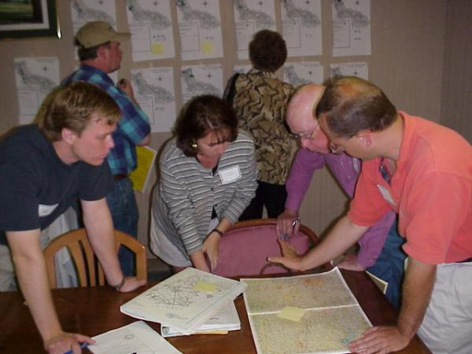
SITE
SELECTION
BREAK!
Fill out Participant Agreement Form,
sign and turn into trainer
Notes:
We would like to take some time to help you complete your forms. We have maps and other information available to help you pick your sites.
Once you complete your form, sign and date it and turn it in. We will now issue the necessary equipment.
After we finish this process, we will come back together for the field chemistry section of this workshop
(BREAK)

